Slide 1
Single Page Application

Slide 2
Multi page web applications vs. single page web applications
MPA is a traditional kind of web application.
every time the application needs to display the data or submit data back to server it has to request a new page from the server and then render it in the web browser.
SPA is essentially an evolution of the MPA+AJAX design pattern
SPA requests the markup and data separately, and renders pages directly in browser

Slide 3
Single-Page Applications (SPAs) are Web apps that load a single HTML page and dynamically update that page as the user interacts with the app. SPAs use AJAX and HTML5 to create fluid and responsive Web apps, without constant page reloads. However, this means much of the work happens on the client side, in JavaScript.

Slide 4
A single-page application (SPA) is a web application or web site that interacts with the user by dynamically rewriting the current page rather than loading entire new pages from a server.
This approach avoids interruption of the user experience between successive pages, making the application behave more like a desktop application.
In a SPA, either all necessary code – HTML, JavaScript, and CSS – is retrieved with a single page load,[or the appropriate resources are dynamically loaded and added to the page as necessary, usually in response to user actions.
The page does not reload at any point in the process, nor does control transfer to another page

Slide 5
Best example of a Single Page Application is Gmail. That is the reason before loading Gmail you see a progress bar, as it fetches everything from server once and then all the rendering is done on the client side with calls to server only for fetching data and not the DOM.

Slide 6
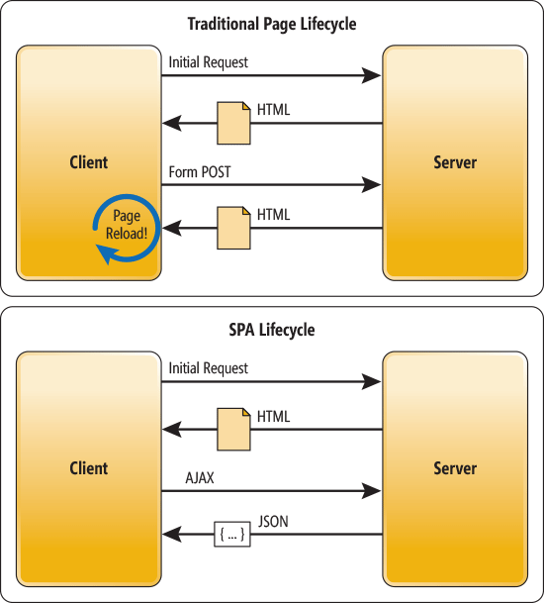

Slide 7
Apart from Gmail, other services in the suite like Google Calendar, Google Drive etc. are also Single Page Applications.

Slide 8
spa framework?
Web browser JavaScript frameworks, such as AngularJS, Ember.js, Meteor.js, ExtJS and React have adopted SPA principles. AngularJS is a fully client-sideframework. AngularJS's templating is based on bidirectional UI data binding.

Slide 9
Technical approaches
There are various techniques available that enable the browser to retain a single page even when the application requires server communication.

Slide 10
AngularJS
Ember.js
Meteor.js
Aurelia
Vue.js
React
Fulcro

Slide 11
Pros of the Multiple-Page Application:
It’s the perfect approach for users who need a visual map of where to go in the application. Solid, few level menu navigation is an essential part of traditional Multi-Page Application.
Very good and easy for proper SEO management. It gives better chances to rank for different keywords since an application can be optimized for one keyword per page.

Slide 12
Cons of Multi-Page Application
Frontend and backend development are tightly coupled.
The development becomes quite complex. The developer needs to use frameworks for either client and server side. This results in the longer time of application development.

Slide 13
Pros of SPA
SPA is fast, as most resources (HTML+CSS+Scripts) are only loaded once throughout the lifespan of application. Only data is transmitted back and forth.
The development is simplified and streamlined. There is no need to write code to render pages on the server. It is much easier to get started because you can usually kick off development from a file file://URI, without using any server at all.
SPAs are easy to debug with Chrome, as you can monitor network operations, investigate page elements and data associated with it.
It’s easier to make a mobile application because the developer can reuse the same backend code for web application and native mobile application.
SPA can cache any local storage effectively. An application sends only one request, store all data, then it can use this data and works even offline.

Slide 14
Cons of SPA
It is very tricky and not an easy task to make SEO optimization of a Single-Page Application. Its content is loaded by AJAX (Asynchronous JavaScript and XML) — a method of exchanging data and updating in the application without refreshing the page.
It is slow to download because heavy client frameworks are required to be loaded to the client.
It requires JavaScript to be present and enabled. If any user disables JavaScript in his or her browser, it won’t be possible to present application and its actions in a correct way.
Compared to the “traditional” application, SPA is less secure. Due to Cross-Site Scripting (XSS), it enables attackers to inject client-side scripts into web application by other users.
Memory leak in JavaScript can even cause powerful system to slow down

Slide 15
A memory leak reduces the performance of the computer by reducing the amount of available memory. Eventually, in the worst case, too much of the available memory may become allocated and all or part of the system or device stops working correctly, the application fails, or the system slows down vastly due to thrashing.

